Slide 1
CSCE 633 Fall 24: Machine Learning Project
Meal Nutrition Analysis
Prakhar Suryavansh (936001838)
Rusali Saha (335006984)
Dipanwita Rano (436000715)

Slide 2
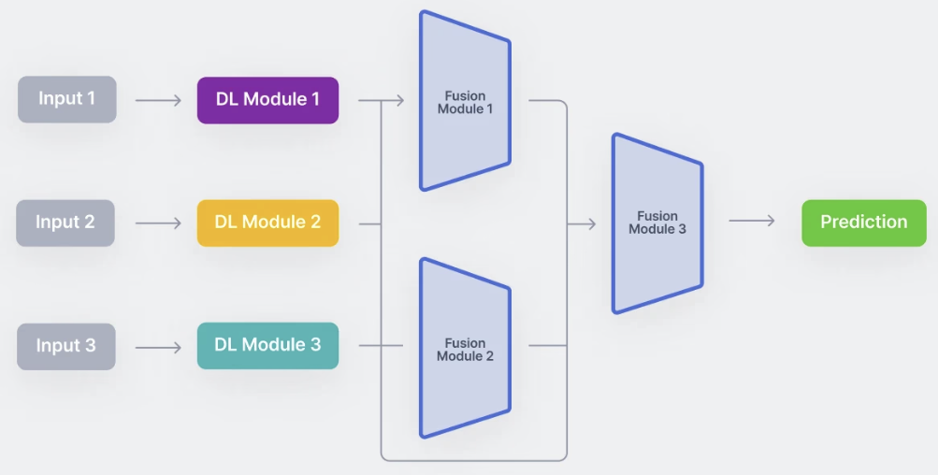
Introduction
Objective - to build a multimodal model to estimate lunch calories using sensor data, images, demographics, micro gut health and breakfast data

Slide 3
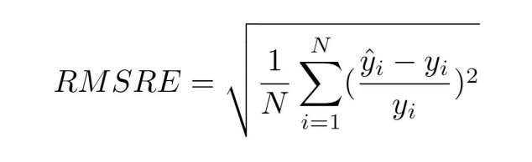
Problem Statement
Given multiple modalities of image data, time series data, numerical and categorical data, perform multimodal learning to predict the amount of calories consumed during lunch
Evaluation metric - Root Mean Square Relative Error
To achieve error lower than predefined Kaggle benchmark of 0.5258

Slide 4
Dataset and Set up
Image data
Lunch Images
Breakfast Images
Time series data (Continuous glucose monitoring data)
CGM data - glucose levels recorded at intervals of 5 minutes, between breakfast time and lunch time
Numerical data (Demo_viome_train data)
Age, Weight, Height, Fasting glucose, Insulin, Cholesterol, etc
Viome - Data based on micro gut health
Categorical data (Demo_viome_train data)
Categorical features - Race, Diabetes Status, Gender
Label data
Breakfast calories, fat, protein, carbohydrate segregation

Slide 5
Methodology - Preprocessing
Integration of modalities to generate merged data - individually processed each modality and combined to create multimodal dataset
Image preprocessing
Normalization
Missing value handling using placeholder
Augmentation
Glucose time series data preprocessing
Missing value handling using placeholder
Resampling using downsampling
Fixed length handling - padding and truncate
Numerical data preprocessing
Standard Scaler
Categorical data preprocessing
One hot encoder

Slide 6
Methodology - Model Architecture
Joint embedding
Convolutional Neural Network - Image
Layer 1: Convolutional layer followed by ReLU activation and max pooling
Layer 2: Convolutional layer followed by ReLU activation and max pooling
Fully connected layer: 128 neurons, ReLU activation.
Long Short Term Memory Network - Time series data
LSTM Layers: Configurable number of layers with configurable number of hidden units
Fully connected layer: 128 neurons
Deep Neural Network - Numerical and categorical data
Fully connected layer 1: 64 neurons, ReLU activation, Dropout
Fully connected layer 2: 128 neurons, ReLU activation, Dropout

Slide 7
Methodology - Model Architecture
Fully connected set of layers
Joint embedding data fed into dense layer
128 neurons
ReLU activation
5-fold Cross validation
Hyperparameter tuning
learning rate
batch size
dropout rate
cnn filters
lstm hidden size
weight decay
optimizer

Slide 8
Experimentation
Initial Overfitting
Ablation study to analyze feature correlation and dependencies
Regularization strategies
Dropout
Weight decay
Feature selection and dimensionality reduction
Chi-square test
Principal Component Analysis

Slide 9
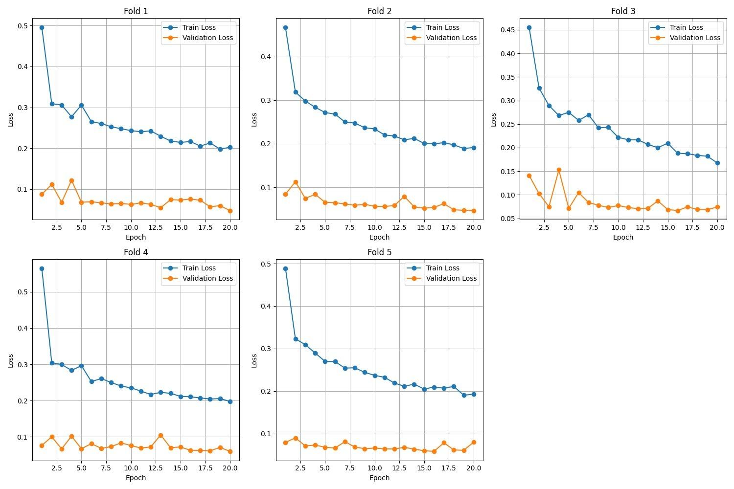
Results
Best validation loss : 0.0422
Final training loss : 0.252
RMSRE loss on test data on Kaggle : 0.256
Observations from plot
Validation loss remains stable after initial few epochs.
Training and validation loss across all folds are consistent.
Best values of parameters
learning rate: 0.01
batch size: 16
dropout rate: 0.2
cnn filters: (32, 64)
lstm hidden size: 128
weight decay: 1e-05
optimizer: Adam

Slide 10
Summary
Multimodal Model to predict lunch calorie intake - consists of 3 types of neural networks.
Initially observed heavy reliance on breakfast-specific data.
Regularization helped in model generalisation.
In common feature selection techniques, like chi-square test, very low individual correlation of microbiome data.
PCA to reduce dimensionality, and preserve 95% of variance in demographic data.
3 different models for 3 different data branches.

Slide 11
References
A. M. Thompson, C. B. Rinaldi, et al., "Challenges in Accurate Calorie Estimation: A Review," Journal of Nutrition Science, vol. 12, pp. 23-45, 2022.
J. Smith, L. Rodriguez, "The Role of Wearable Devices in Dietary Monitoring," IEEE Transactions on Biomedical Engineering, vol. 68, no. 4, pp. 1234-1245, 2021.
K. Gupta, M. Sharma, et al., "Multimodal Deep Learning for Food Calorie Estimation," Proceedings of the IEEE Conference on Computer Vision and Pattern Recognition (CVPR), 2020.
S. Patel, R. Kumar, et al., "Integrating Visual and Contextual Information for Accurate Calorie Prediction," IEEE Transactions on Neural Networks and Learning Systems, vol. 33, no. 6, pp. 1567-1579, 2023.
B. J. Mortazavi and R. Gutierrez-Osuna, "A Review of Digital Innovations for Diet Monitoring and Precision Nutrition," IEEE Reviews in Biomedical Engineering, vol. 14, pp. 120-135, 2021.
Y. Zhang, M. Li, et al., "Multimodal Learning for Activity Recognition Using Wearable Sensors," IEEE Transactions on Neural Systems and Rehabilitation Engineering, vol. 28, no. 3, pp. 689-698, 2020.

Slide 12
Thank You

